Slide 1
An Unusual presentation of Carcinoid tumor
DEPARTMENT OF MEDICAL ONCOLOGY
Presenter – J. PRABAKARAN ( PG in Gen Med )

Slide 2

HISTORY
Mr Kannan, 22 y/M , a computer technician, comes from Kallupatti with
Chief c/o
non productive cough for 1 year

Slide 3
HISTORY
H/o chronic cough – insidious onset, progressive
non productive in nature,
not associated with chest tightness / syncope
not precipitated by cold air / strong odor
No H/O Fever, chills, and pleuritic chest pain
No H/O Hemoptysis
No H/O Breathlessness

Slide 4
HISTORY
No H/O Heartburn
No H/O dysphagia
No H/O Hoarseness of voice
No H/O Night sweats
No H/O Loss of appetite and weight loss
PERSONAL HISTORY
Non smoker
Occasional alcoholic

Slide 5
GENERAL EXAMINATION
Moderately built and moderately nourished
Afebrile
No pallor
No icterus
No cyanosis
No clubbing
No pedal edema
No generalized lymphadenopathy

Slide 6
VITALS
Pulse: 90/mt
BP:120/80
mmHg
RR: 12/mt
SpO2: 98%

Slide 7
CVS
RS
CNS
ABD
S1S2 +
AP in normal position
No murmur
Soft
Non tender
No organomegaly
Trachea in midline
AE reduced in Lt mammary, axillary, infraaxillary, interscapular and infrascapular area
Coarse leathery inspiratory crackles over Lt interscapular, infracscapular area
No focal neurological deficits

Slide 8
BASIC INVESTIGATIONS
HB 12.0
TC 5400 DC 72/22/6
ESR 10mm/hr
PLATELETS 1.9 LAKHS
TOTAL BILIRUBIN – 0.9
SR PROTEIN -7.1
UREA 29
SGOT- 35 SGPT- 39 ALP- 49
CREATININE0.9
RBS 100MG/DL
SR ALBUMIN- 4.0
SR GLOBULIN -3.1

Slide 9
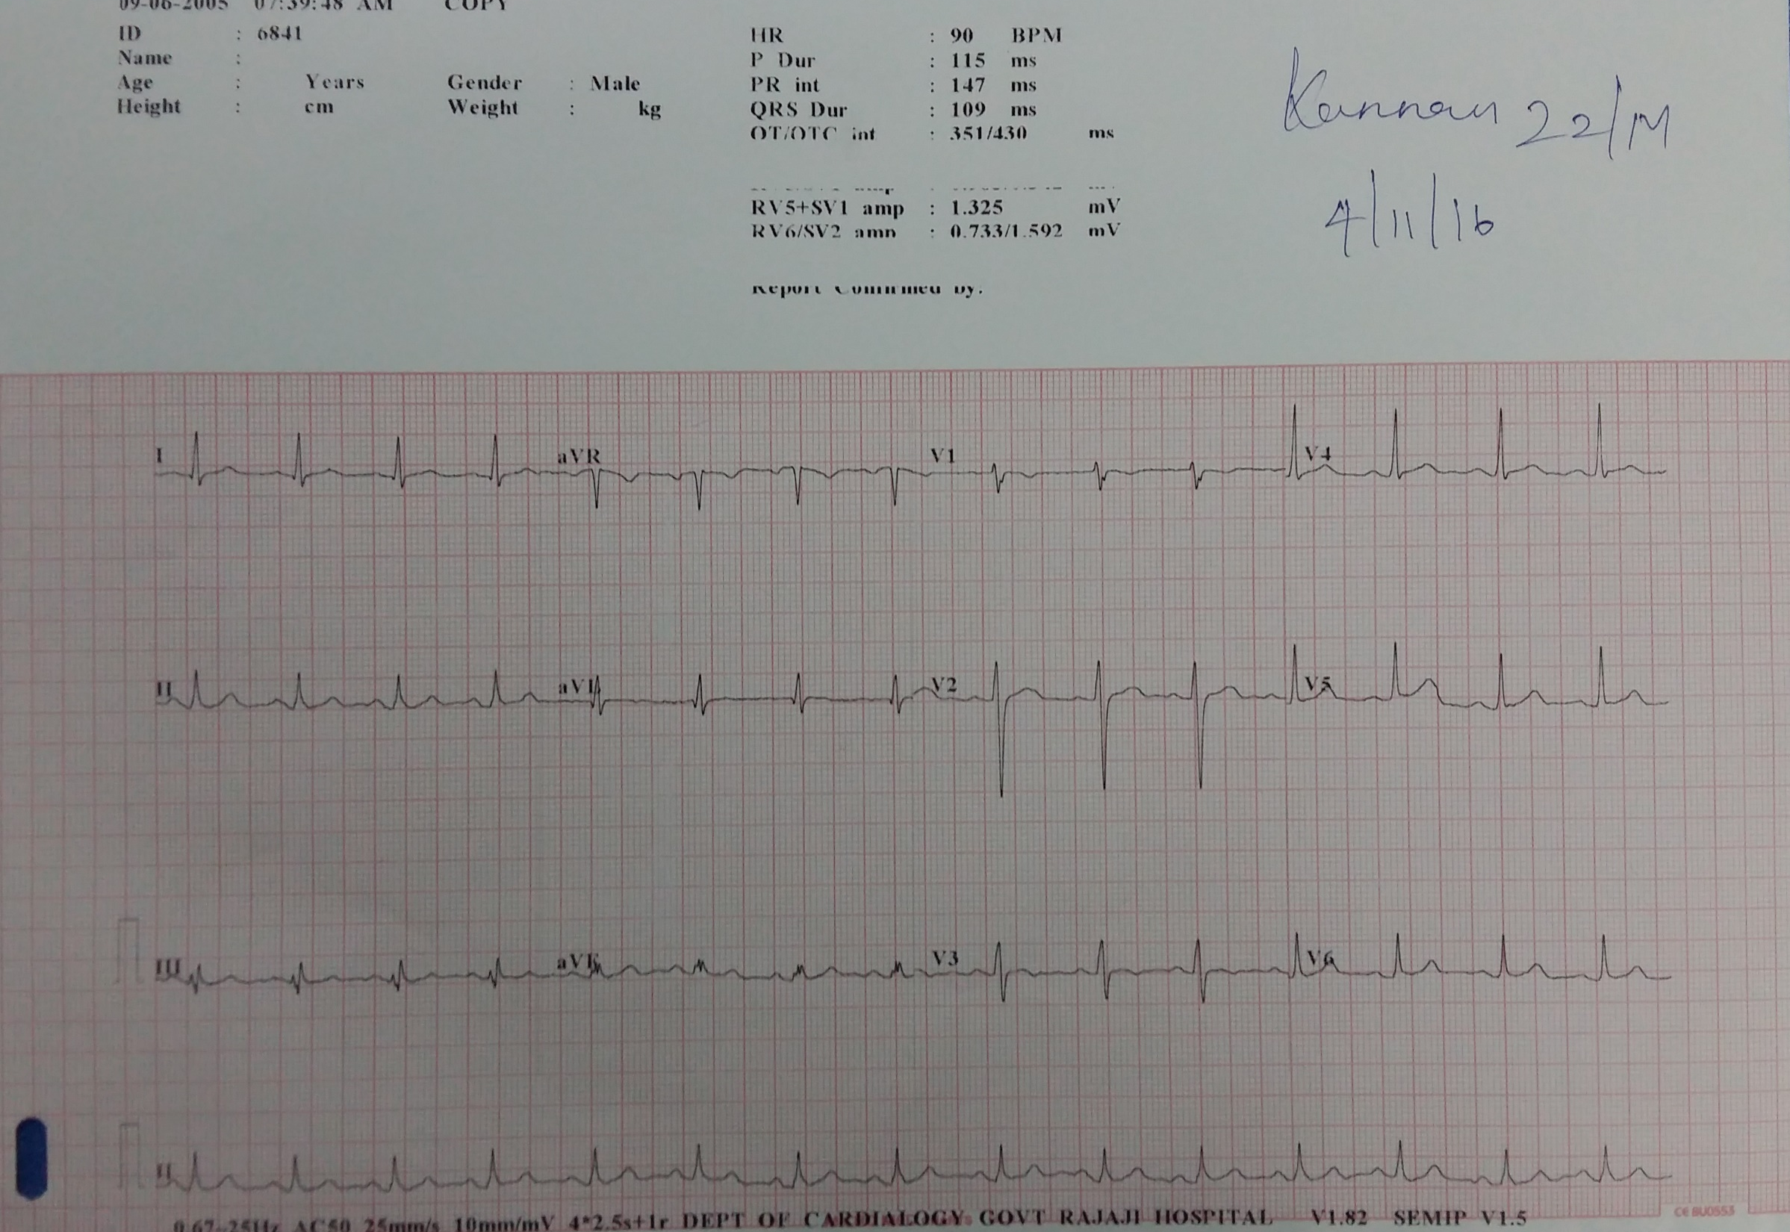

Slide 10

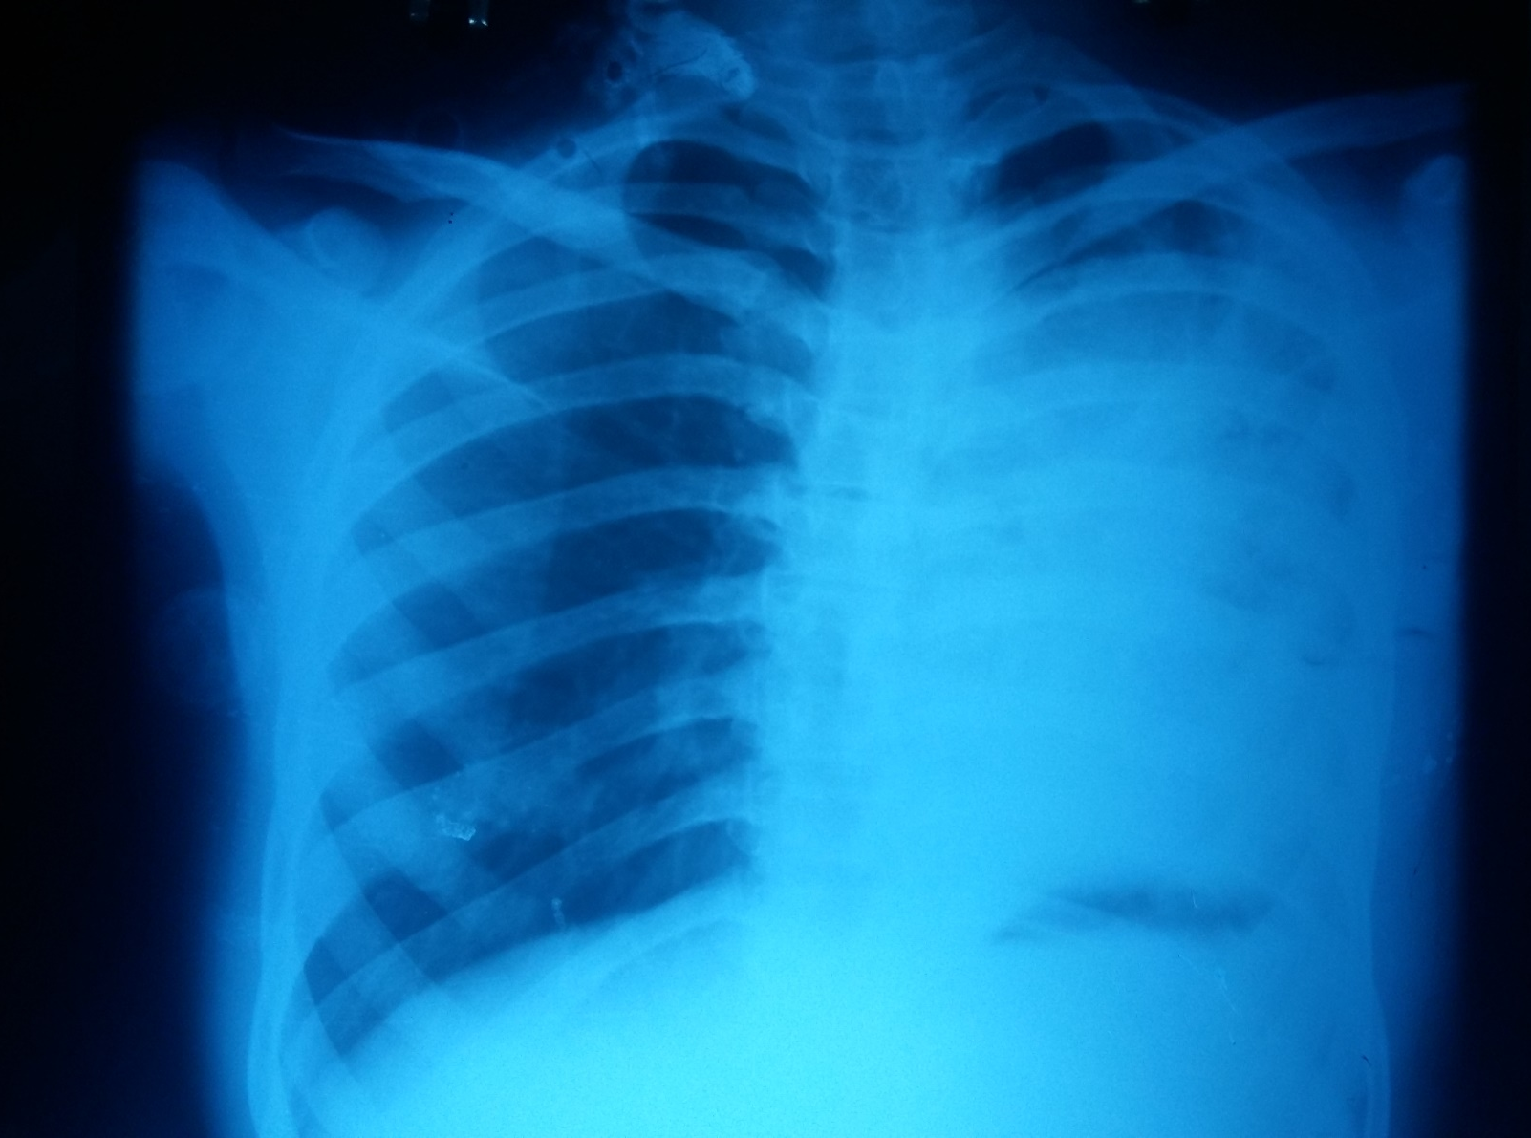

Slide 11

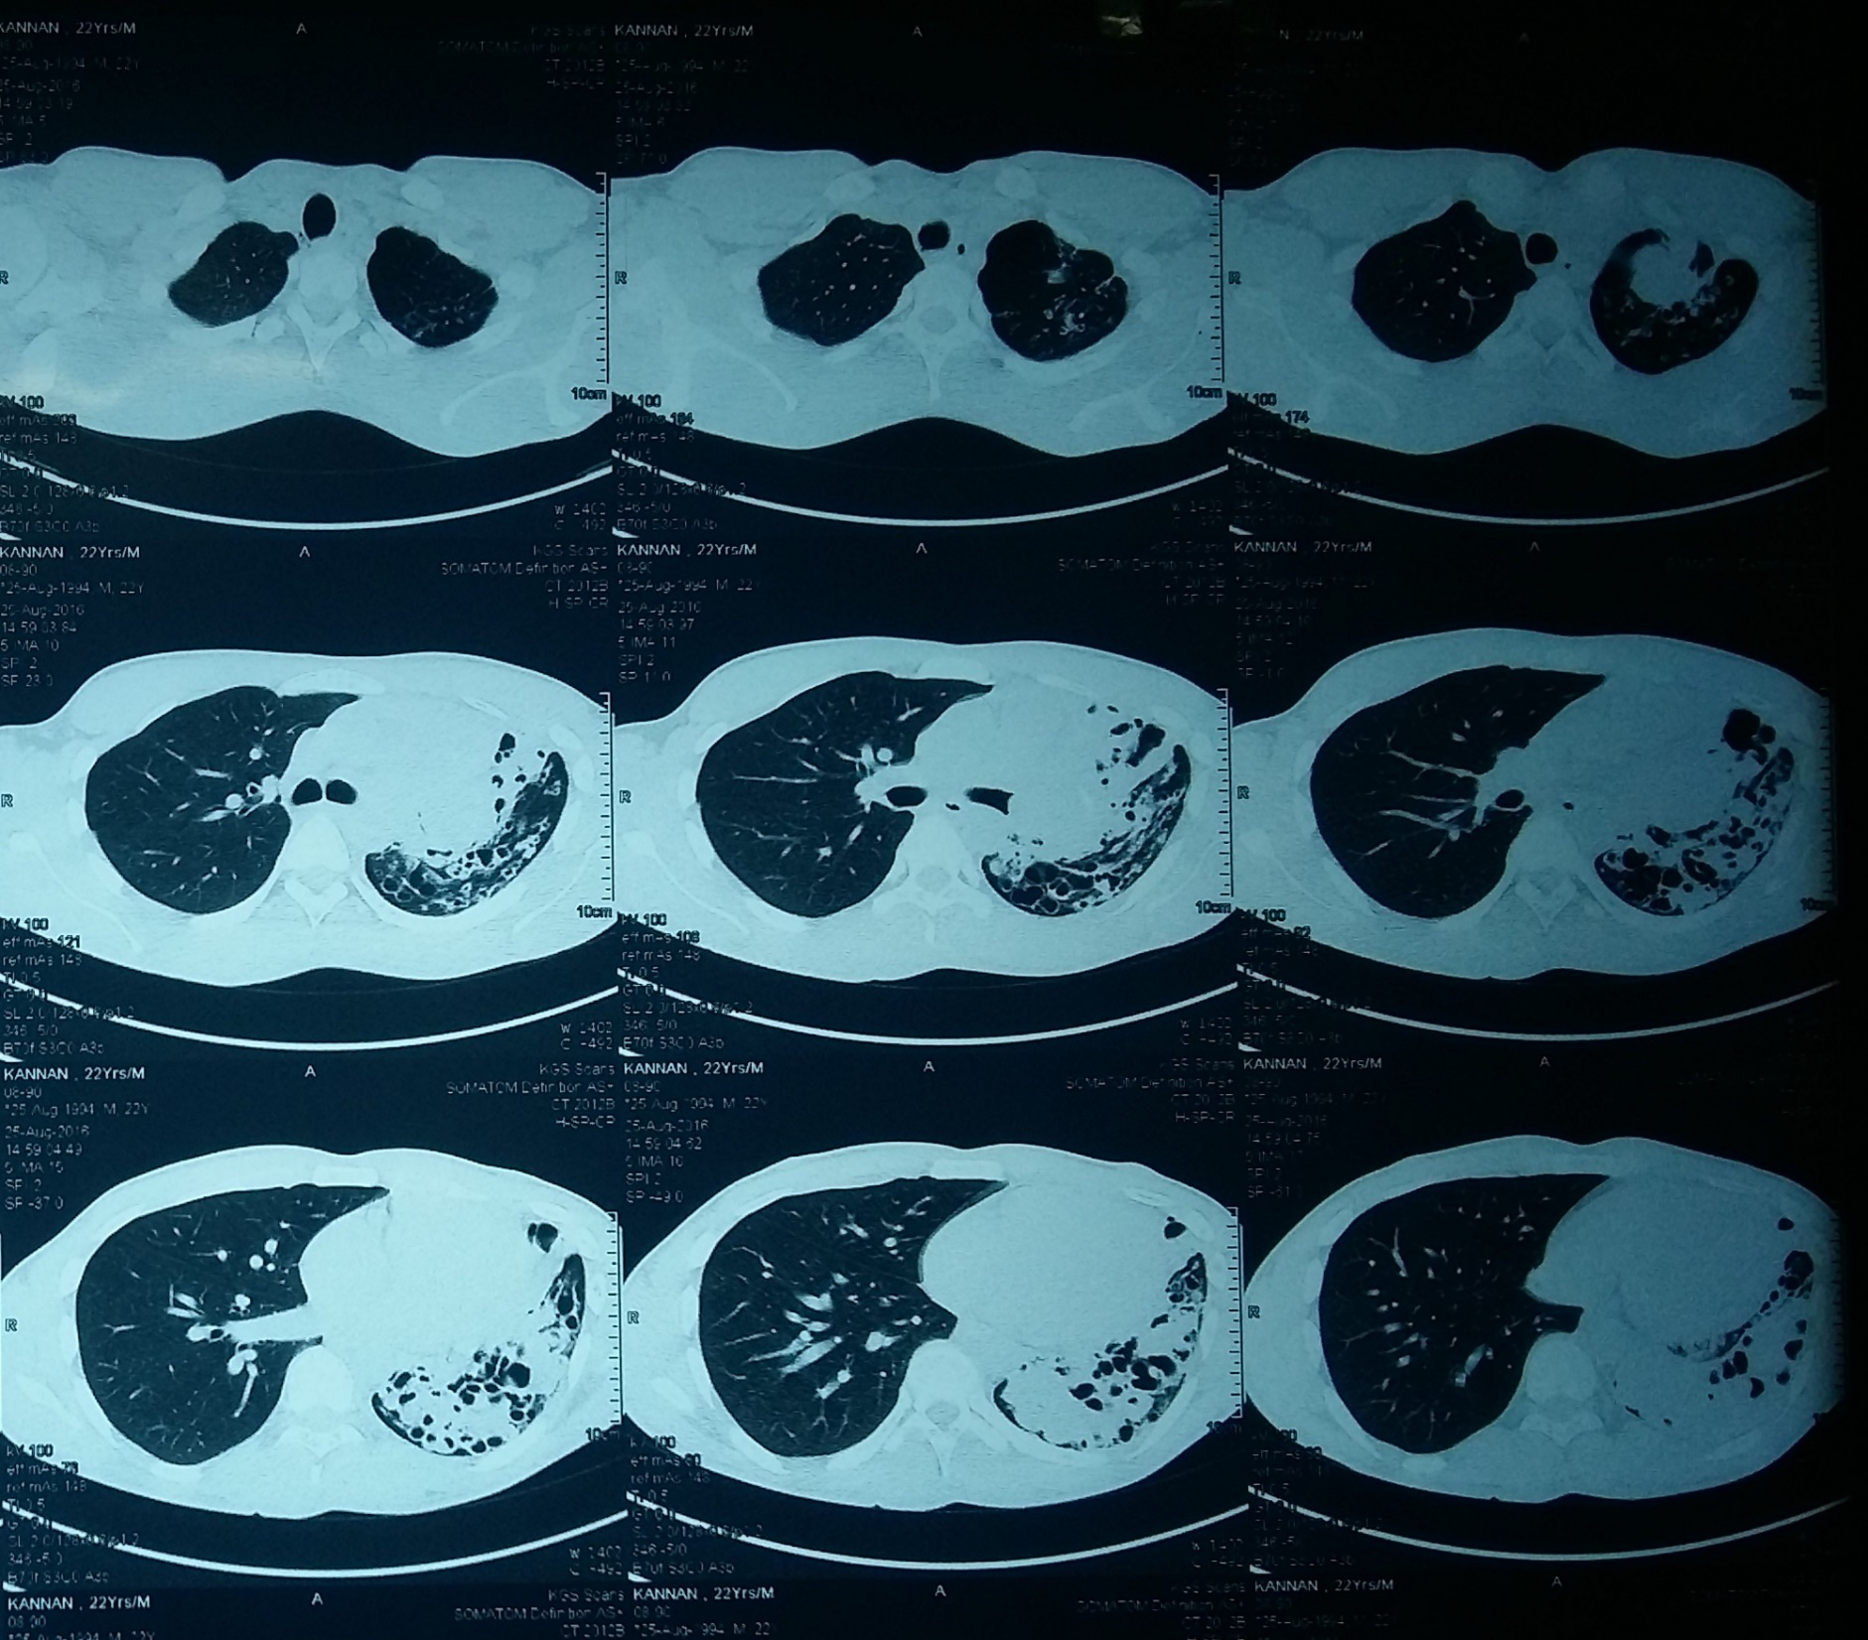
CT CHEST

Slide 12
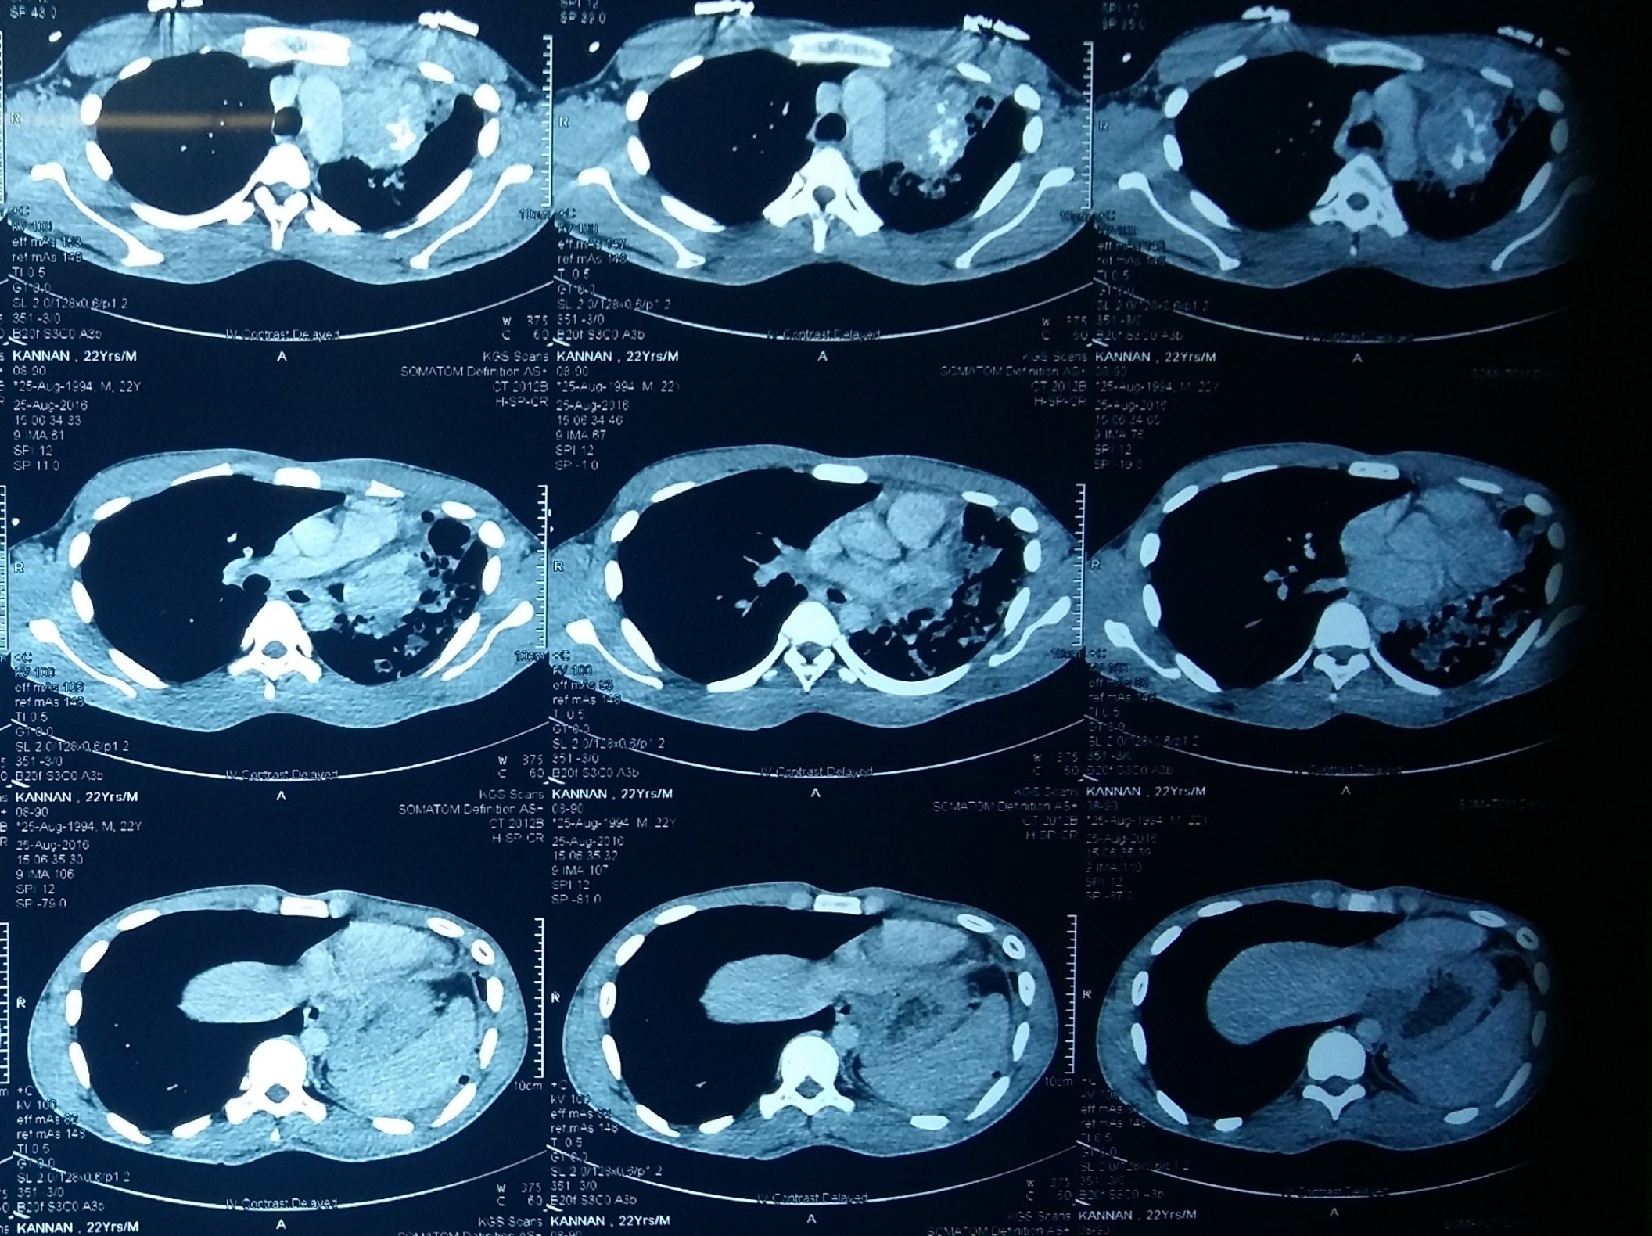
CT CHEST

Slide 13

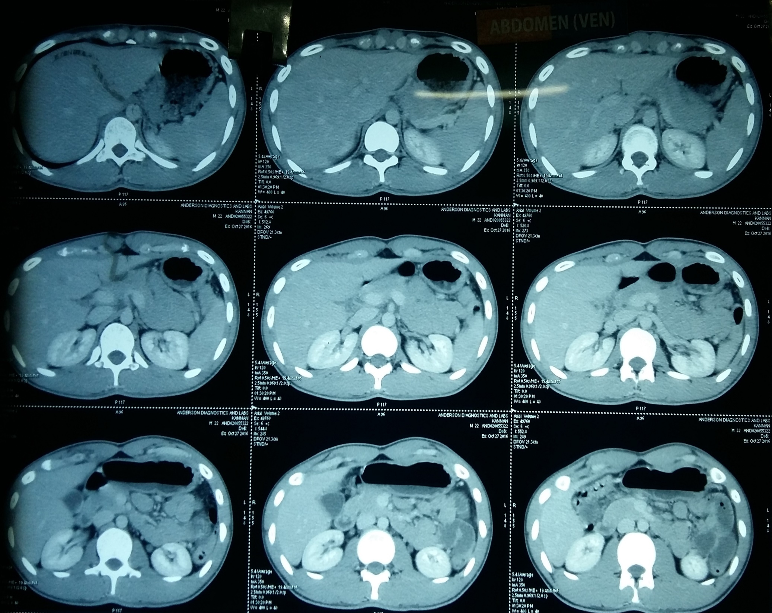
CT ABDOMEN

Slide 14
SPUTUM EXAMINATION
Sputum AFB – Negative
Cytology – Negative for malignant cells

Slide 15
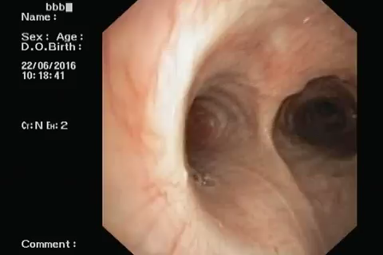
FIBRE OPTIC BRONCHOSCOPY

Slide 16
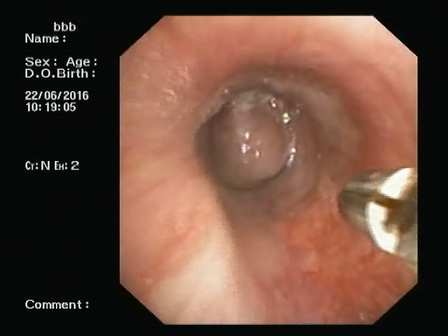
ENDOBRONCHIAL WASH & BIOPSY
WASH – S/O Atypical cells
BIOPSY – SMALL CELL CARCINOMA

Slide 17
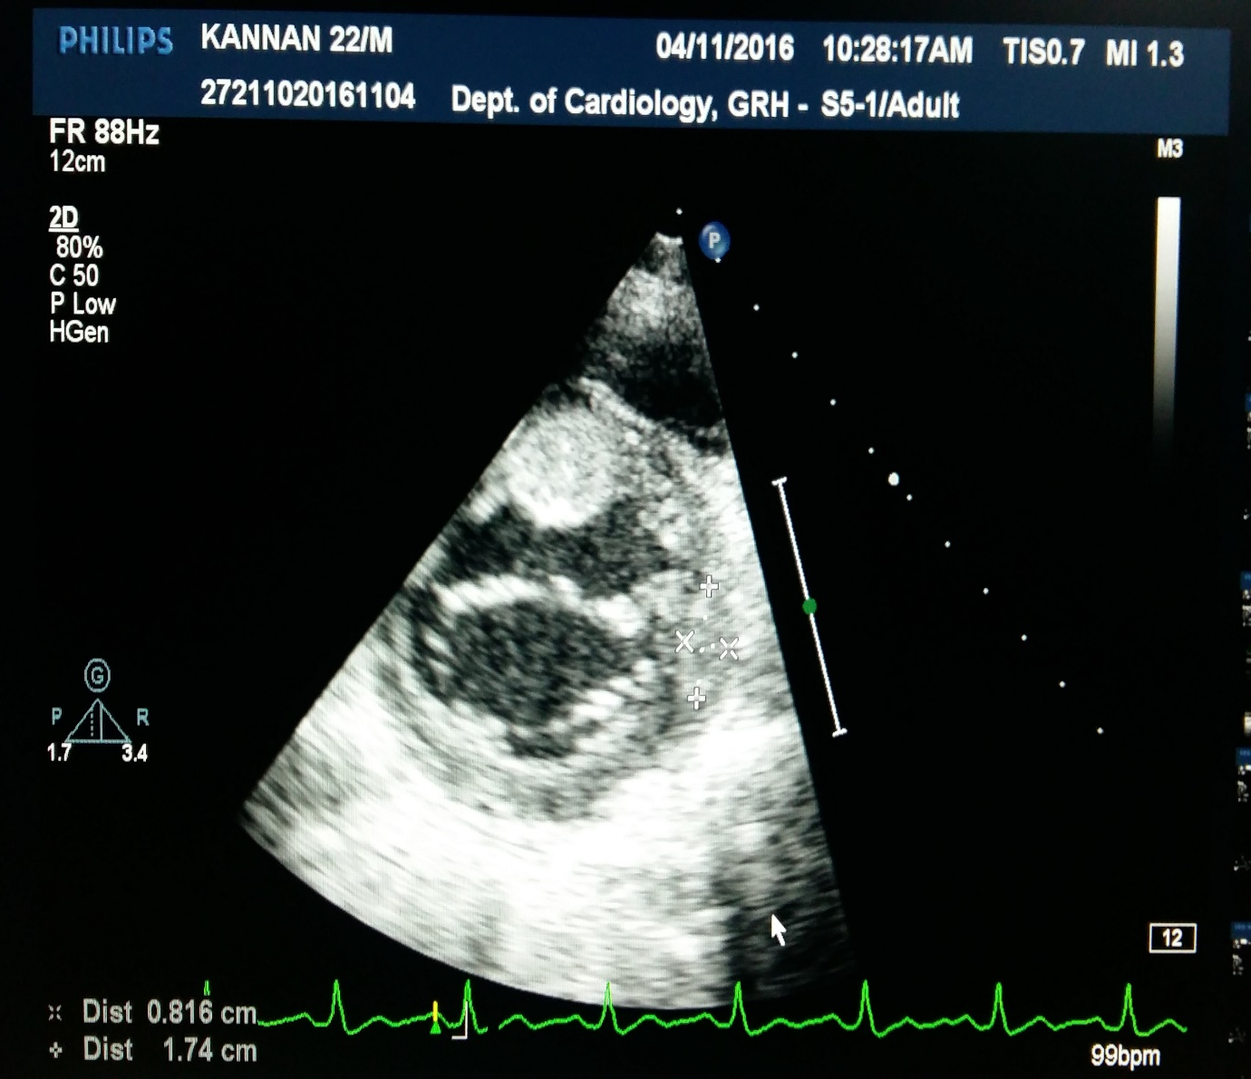
ECHO
Normal valves
Multiple intramyocardial masses seen
mass 1 – upper IVS 1.5 * 1.6 cms
mass 2 – mid lateral wall 1.5 * 0.8 cms
No RWMA
Normal LV systolic function ( EF – 69%)
IMPRESSION – INTRAMYOCARDIAC MASSES

Slide 18

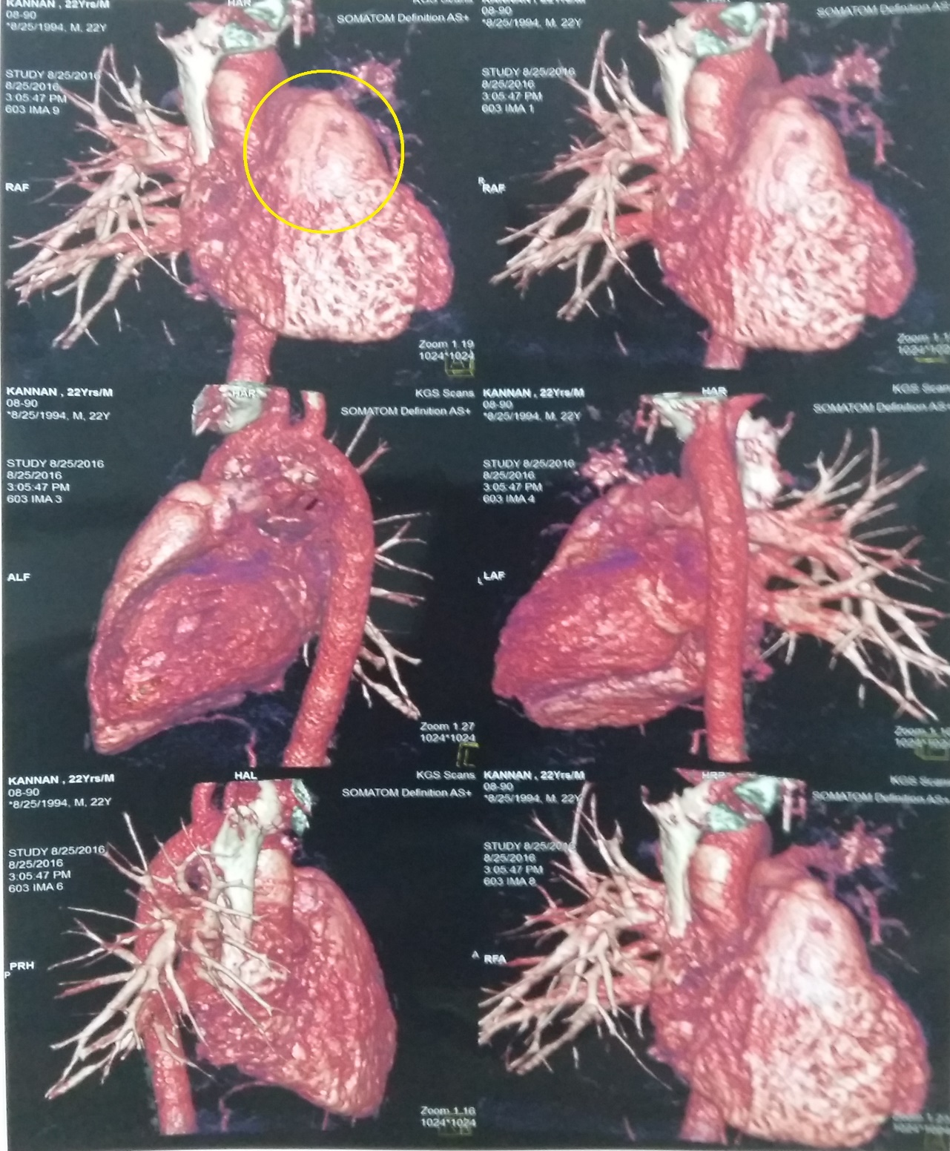
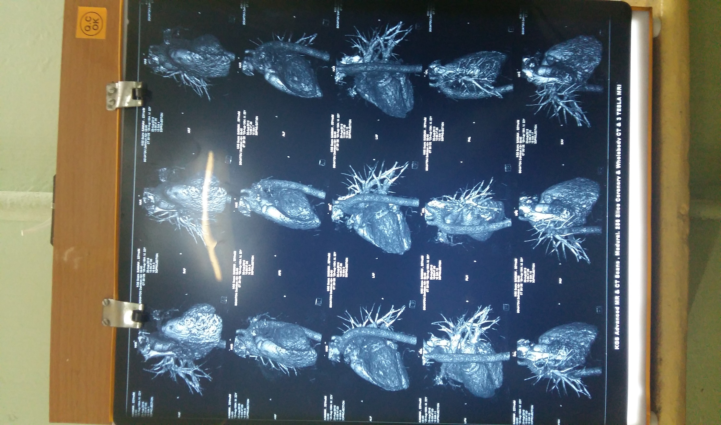

Slide 19
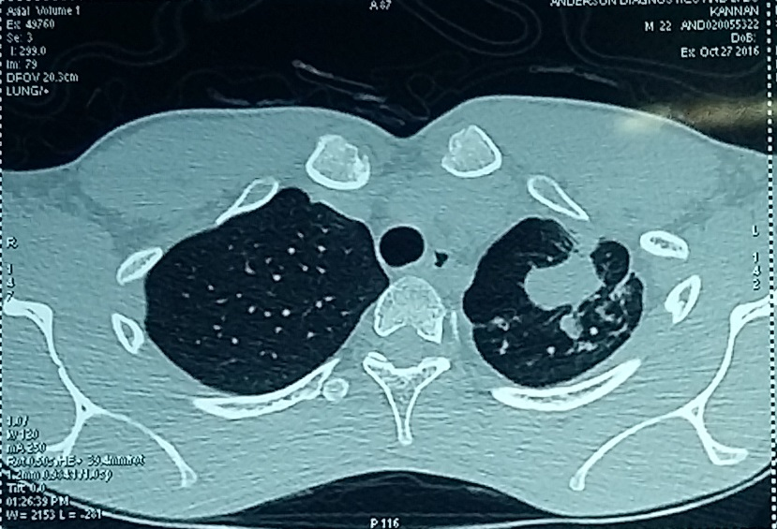
CT GUIDED BIOPSY (LUNG)

Slide 20
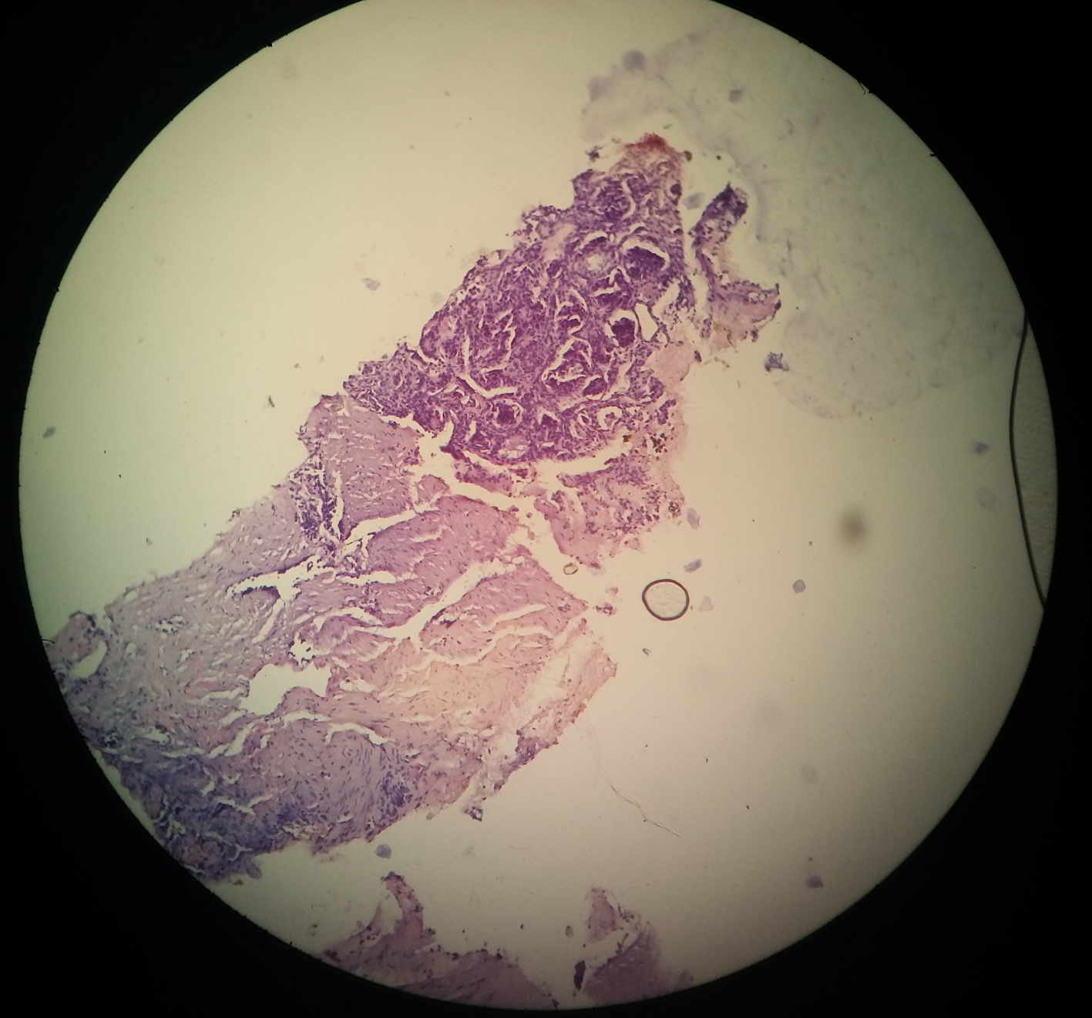
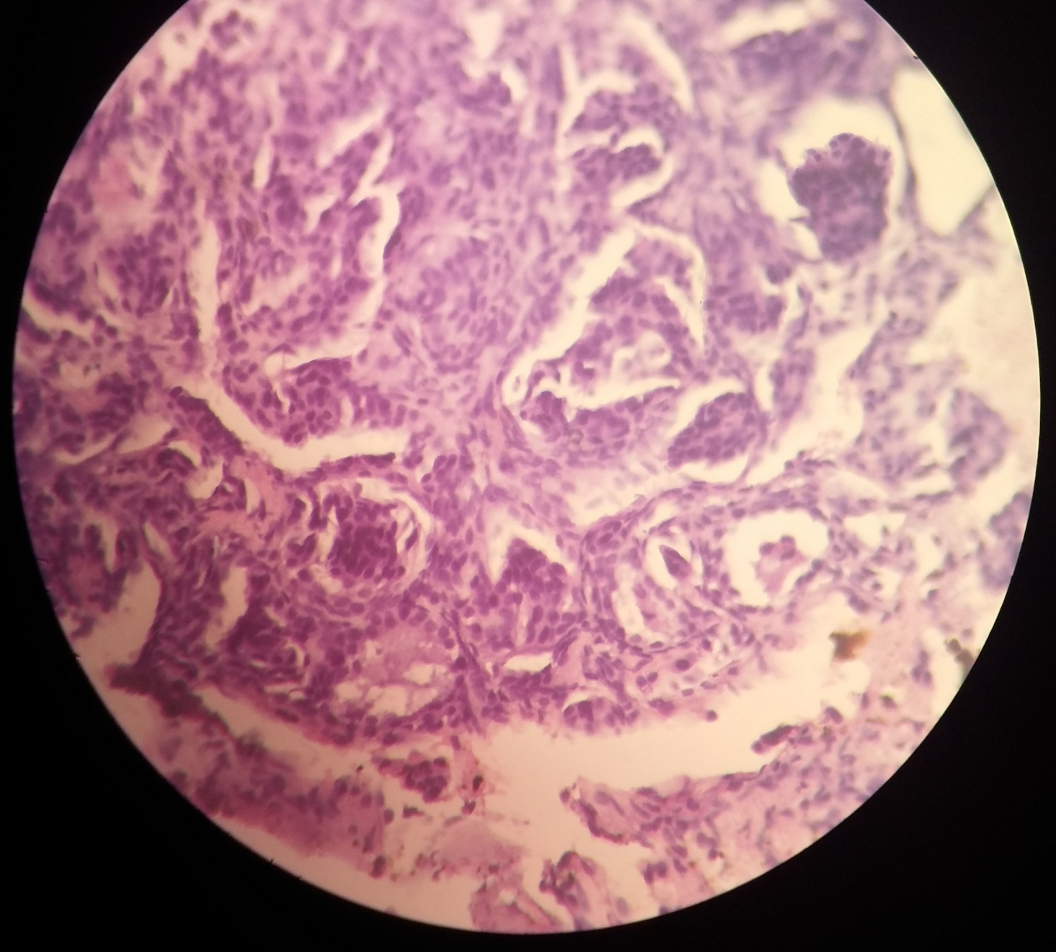
HISTOPATHOLOGICAL EXAMINATION

Slide 21
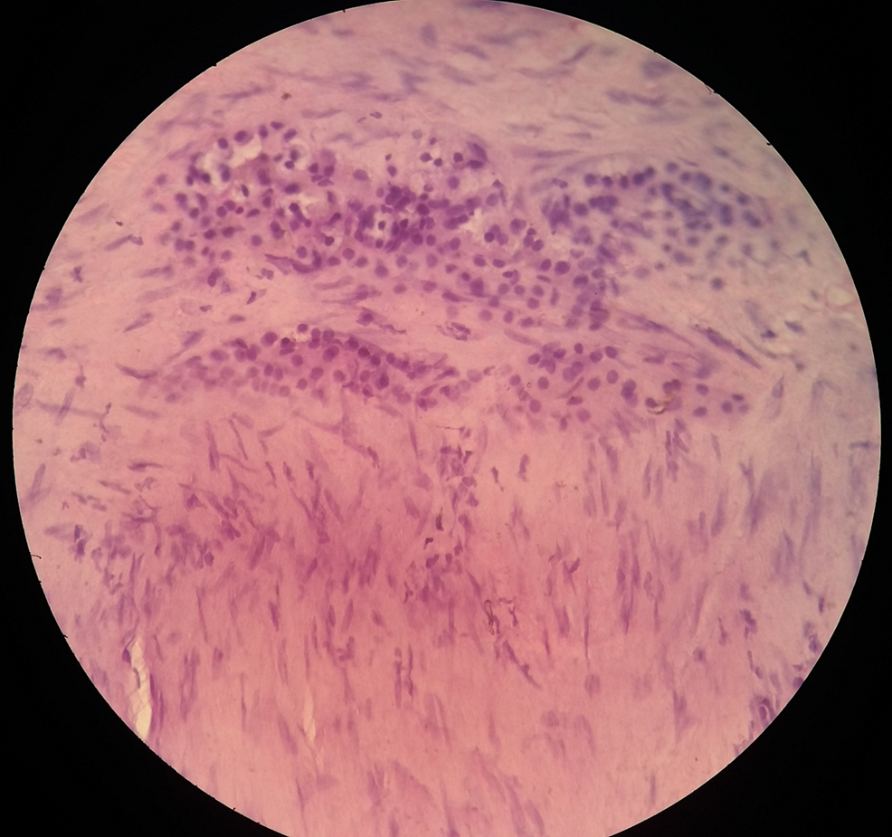
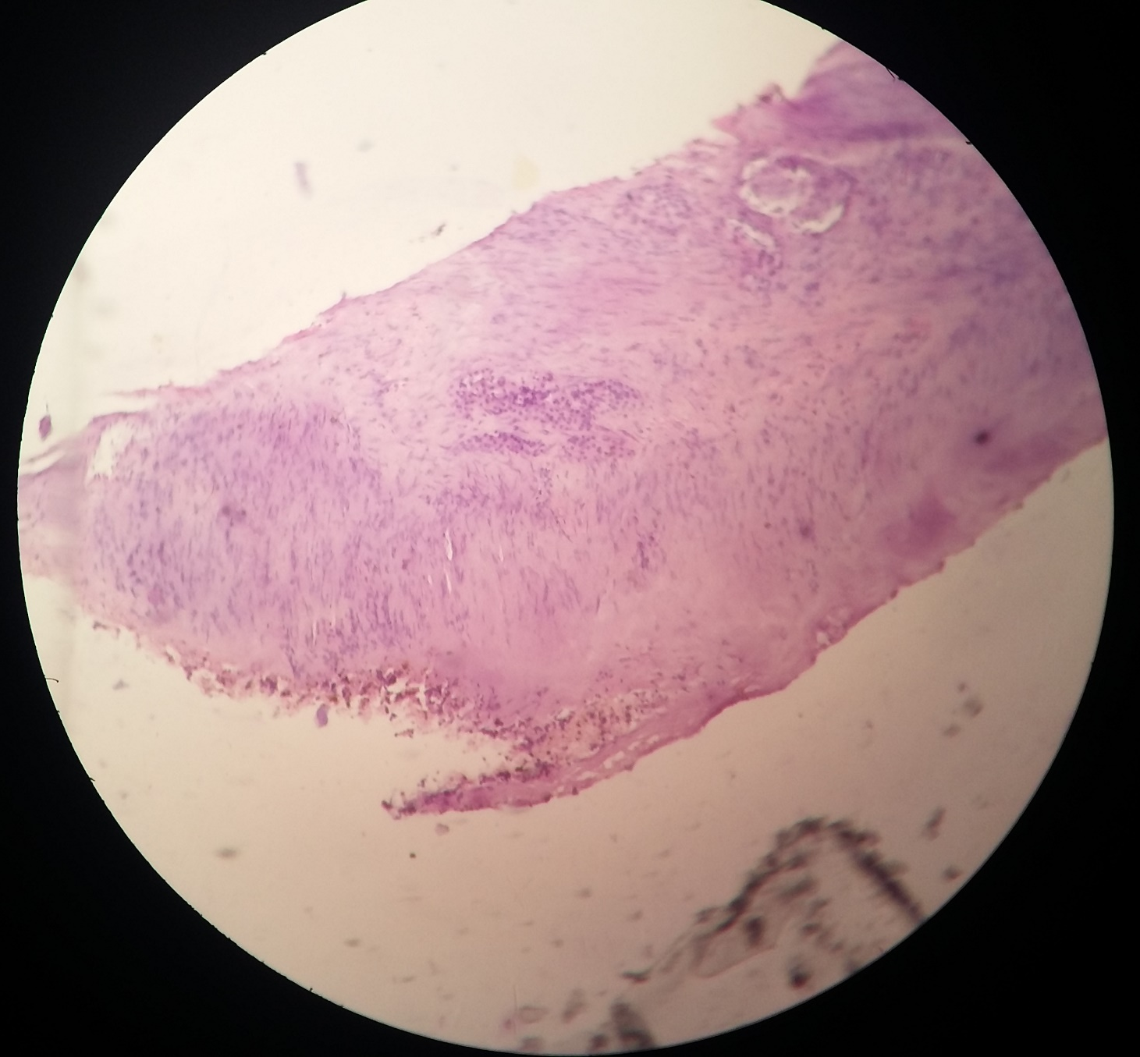
HISTOPATHOLOGICAL EXAMINATION

Slide 22
HISTOPATHOLOGICAL EXAMINATION
Sections from the lung tumor show small malignant cells with round to oval nuclei arranged in solid nest, trabecular pattern and tubular pattern with invasion into the surrounding fibrous stroma.
Picture is s/o MALIGNANT CARCINOID TUMOR
Suggested IHC study

Slide 23
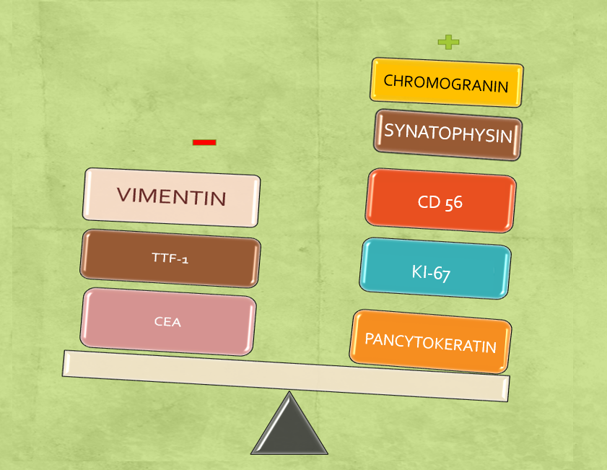
IMMUNOHISTOCHEMISTRY
Suggestive of NEUROENDOCRINE TUMOR

Slide 24
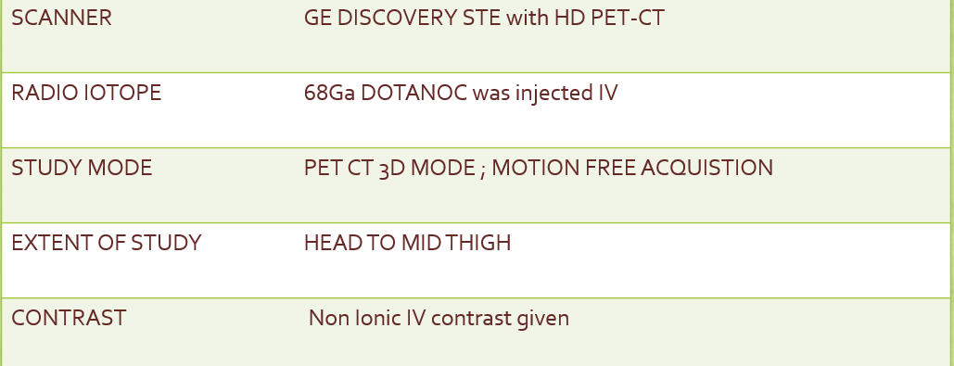
STAGING SCAN
Ga68-DOTANOC-PET CT WHOLE BODY ( 64 SLICE ) with MRI HYBRID FUSION
Gallium Ga 68-DOTANOC is a conjugate of the somatostatin analogue 1-Nal3-octreotide (NOC) and gallium Ga 68-labeled 1,4,7,10-tetraazacyclododecane-N,N',N'',N'''-tetraacetic acid (DOTA).

Slide 25

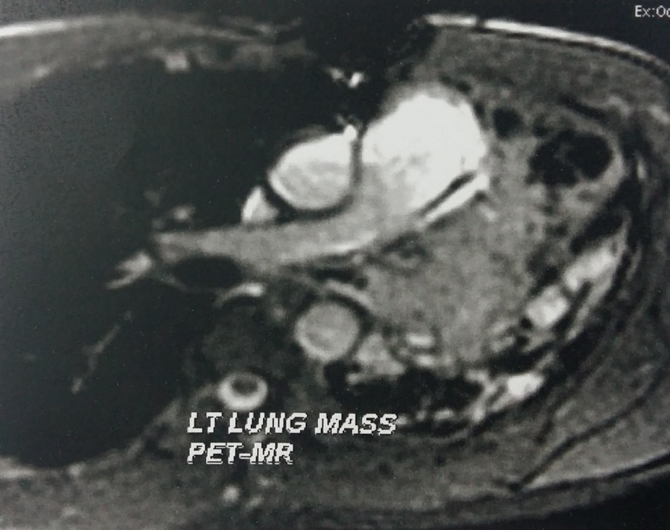
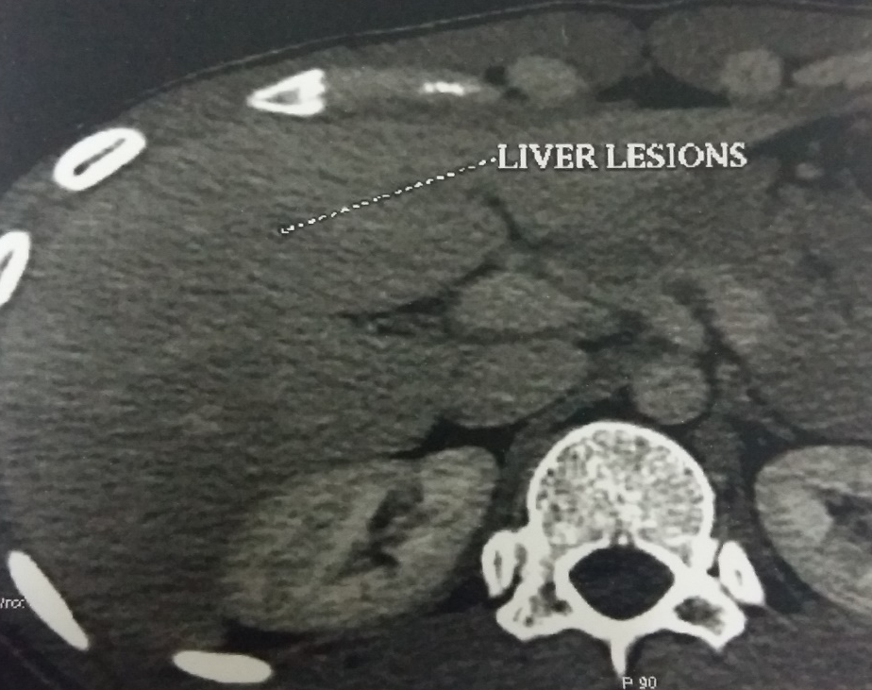
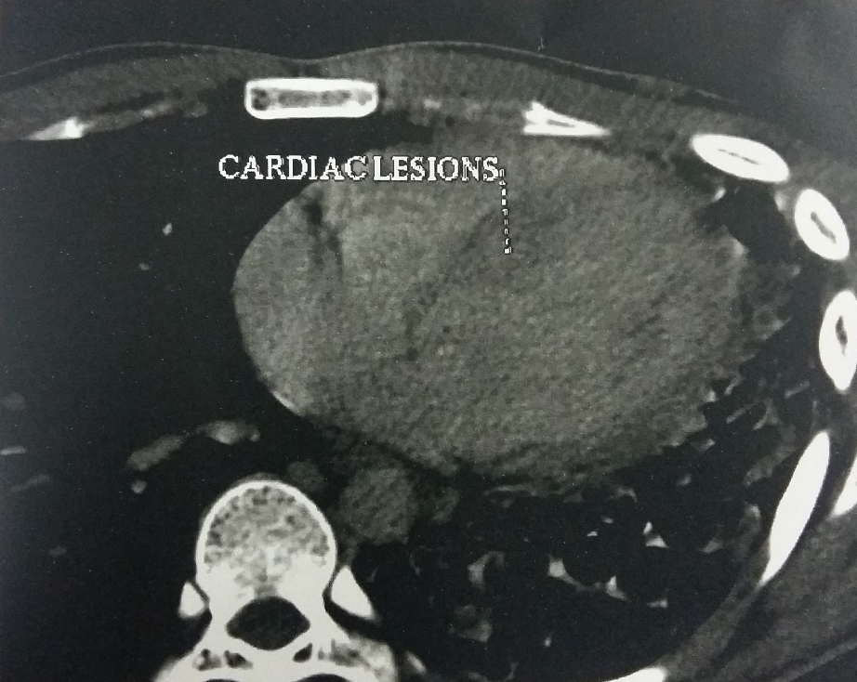
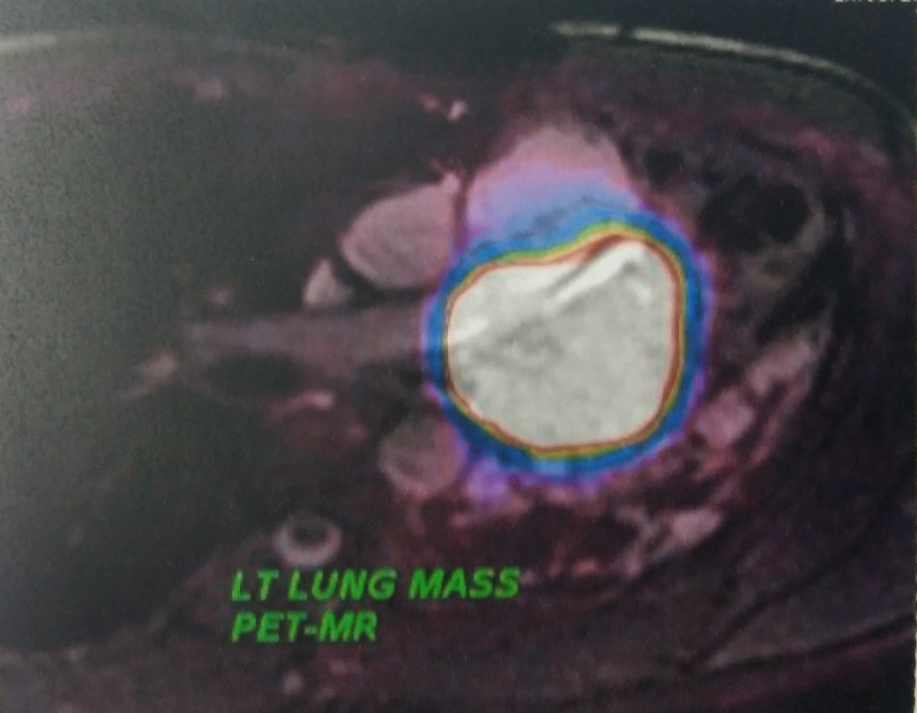
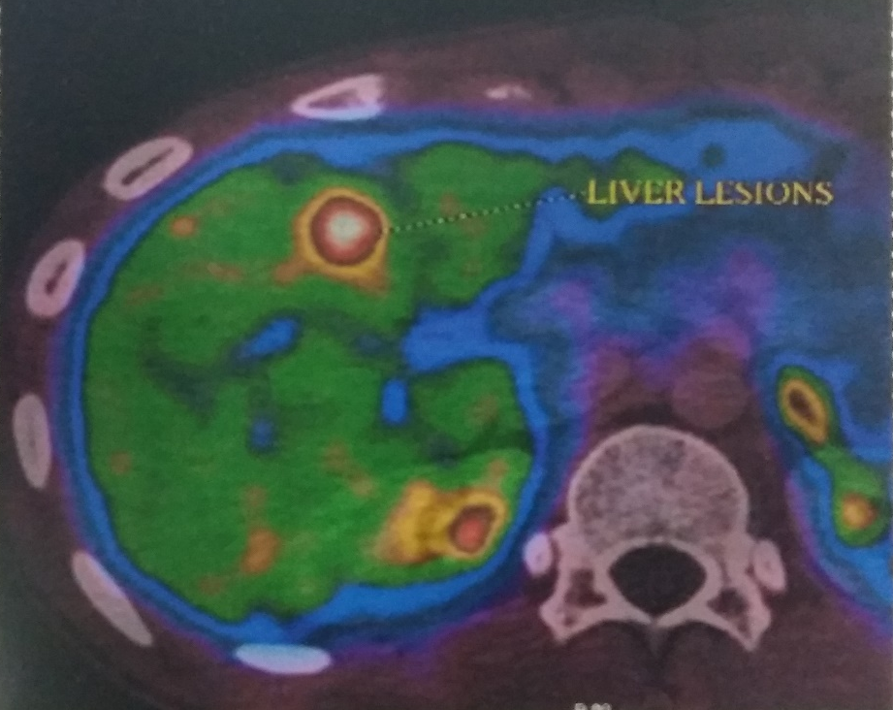
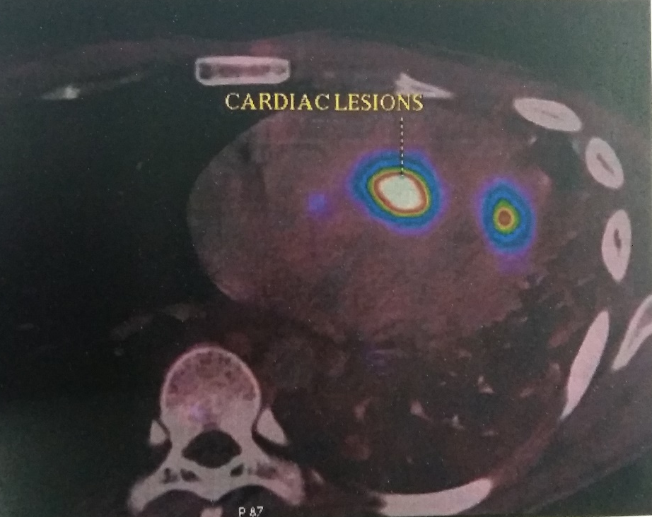

Slide 26
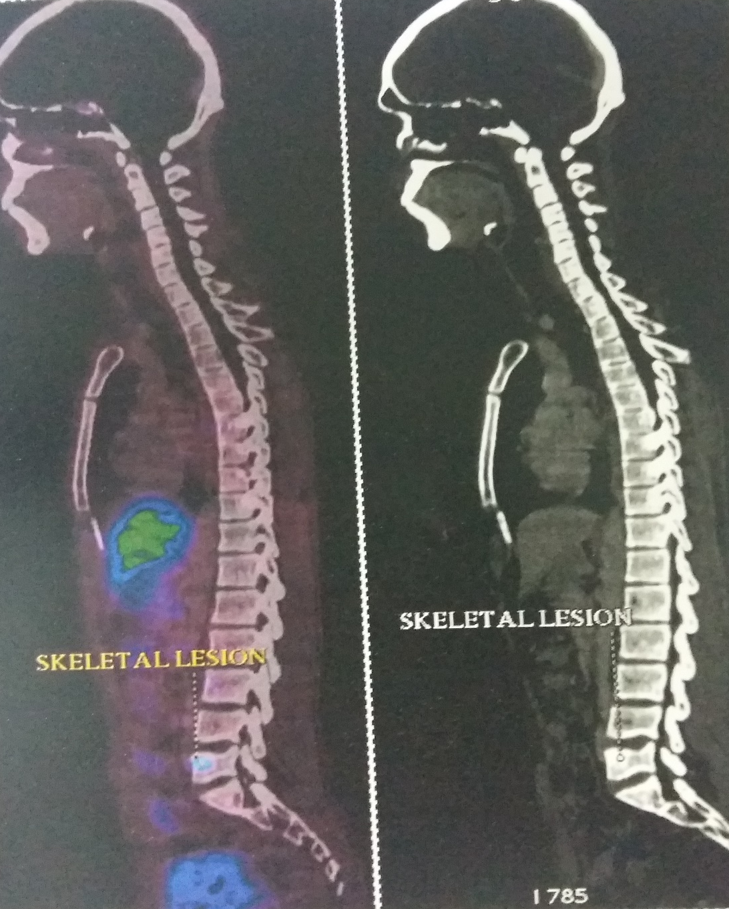
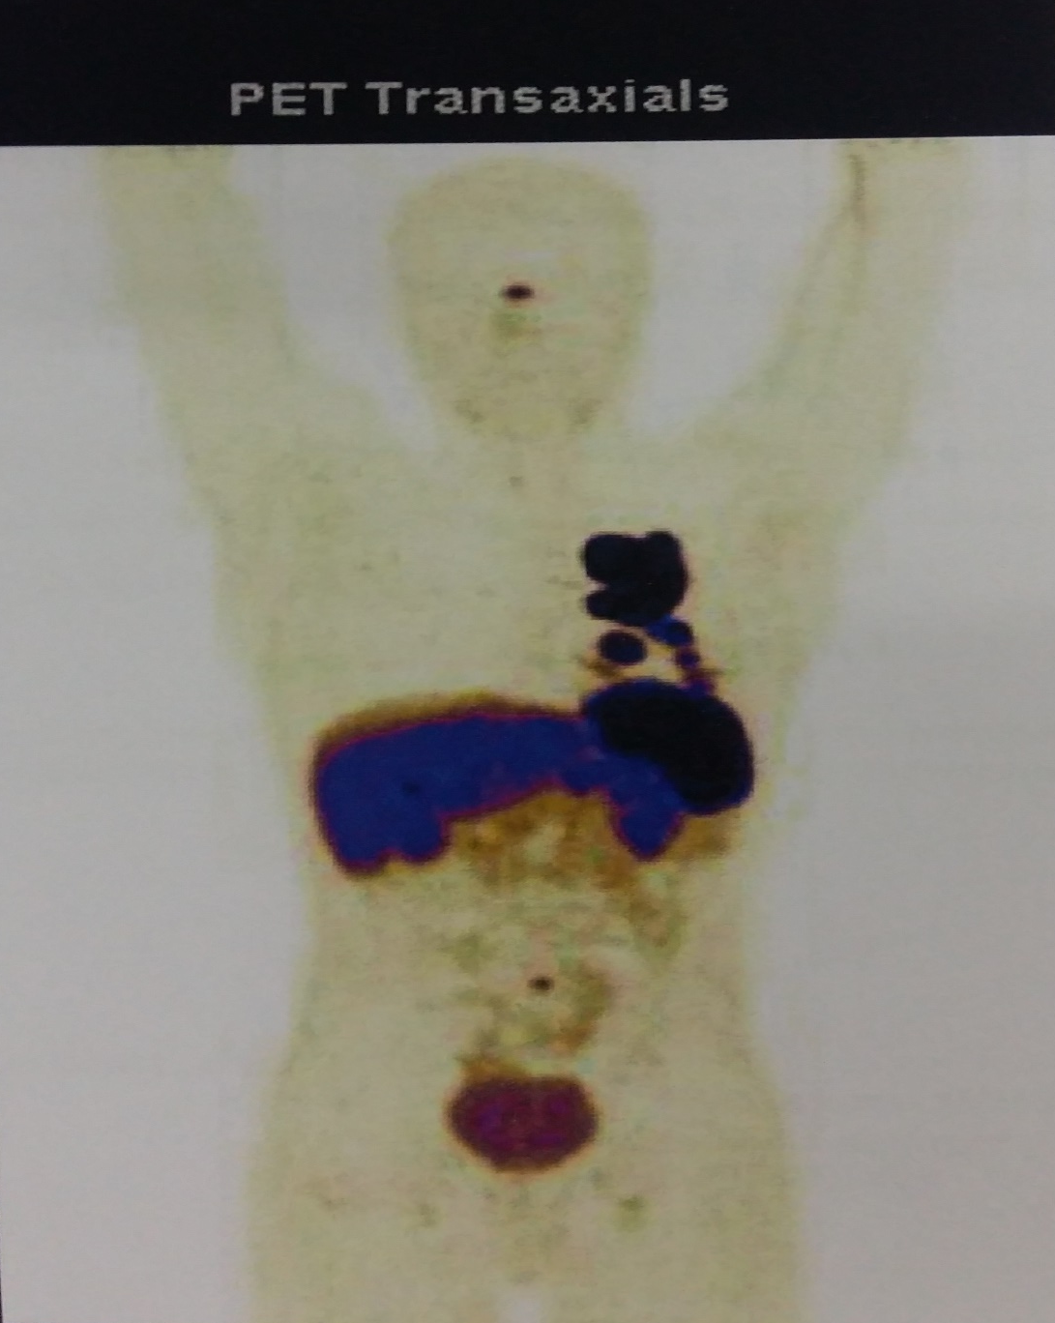

Slide 27
DOTA-NOC PET CT/MRI IMPRESSION
Heterogeneously enhancing mass lesion in the anterior segment of left upper lobe extending to left hilar region
Single nodule in the lateral segment of right middle lobe of lung
Nodules in the septal, apical, lateral left ventricular myocardium
Few hypodense lesions in liver
Focal sclerotic lesion in the L5 vertebral body

Slide 28
HORMONAL ASSAYS
URINARY 5 HIAA – 7.7 mg / 24 hrs [ 6 – 10]
ACTH – 63.3 pg/ml [ </= 46 ]
GROWTH HORMONE – 3.55 ng/ml [ </= 3.00]

Slide 29
FINAL
DIAGNOSIS
Malignant Carcinoid tumor of Lt lung with hepatic, cardiac, skeletal and probable Rt lung metastasis

Slide 30
THANK YOU

