Slide 1
Extended poisoning!
1st MEDICAL UNIT
CHIEF:PROF.DR.NATARAJAN.MD
ASSISTANT PROFESSORS:
DR.PALANIKUMARAN.MD
DR.VASANTHAKALYANI.MD.DCP
DR.SURESHKUMAR.MD

Slide 2
A 25 year old male was brought to GRH Madurai with complaints of weakness of both lower limbs for past 4 days.
H/O PRESENTING ILLNESS:
About 40 days before patient was apparently normal after which he consumed CHLORPYRIFOS 50% + CYPERMETHRIN 5% about 100 ml .When he reached our hospital he was in an unconscious state and was immediately intubated.

Slide 3
Tracheostomy was done on day 13. Patient’s condition gradually improved and he was discharged on Day 20.During the stay Of patient ,2 packed cell was transfused.
AFTER DISCHARGE,
He was normal for 10 days except had mild difficulty to standing from squatting position. 11th day after discharge he developed weakness of left lower limb followed by right lower limb.

Slide 4
H/o inability to roll over the bed/ inability to get up from supine position.
H/O Difficulty in holding slippers
H/O Difficulty in climbing stairs
H/O SIGNIFICANT LOSS OF WEIGHT +(20Kgs in 1 month)
No H/O Trauma
No h/o Fever/cough/breathlessness.
No H/O bladder and bowel disturbances.
No H/o diarrhoea
No H/o headache/vomiting.
No H/o speech disturbance.
No H/o convulsions/loss of consciousness.

Slide 5
PAST H/O:
Not a K/C/O SHTN/T2DM/PTB
No previous similar episodes.
PERSONAL H/O:
Takes mixed diet.
Bladder and bowel habits normal.
Smoker and alcoholic for past 3 years.

Slide 6
General examination:
Patient conscious,oriented,afebrile,
mild pallor, No pedal edema,
no cyanosis, no clubbing ,
No generalized lymphadenopathy.
VITALS:
BP: 120/70 mmHg in right upper limb in supine position
PR:75/min
spo2: 98% in room air.

Slide 7
Systemic examination:
Cvs: S1S2 Heard. No murmurs.
RS: Bilateral Air entry present. NVBS(+).
CNS:
Conscious
oriented
obeys oral commands
HIGHER MENTAL FUNCTION : Normal
CRANIAL NERVE EXAMINATION:Normal.

Slide 8
Motor system examination:
 | RIGHT | LEFT
BULK | ARM-18cm FOREARM-19 cm THIGH:28cm LEG:24cm | ARM-19cm FOREARM-20cm THIGH:28cm LEG:24cm
TONE | UL: NORMAL LL:HYPERTONIA | UL:NORMAL LL:HYPERTONIA.
POWER | UL:5/5 LL:3/5 HAND GRIP GOOD | UL: 5/5 LL:3/5 HAND GRIP GOOD
FASCICULATIONS ABSENT AT REST.HOWEVER DURING HYPERVENTILATION FASCICULATIONS OBSERVED IN RIGHT PECTORAL REGION.

Slide 9
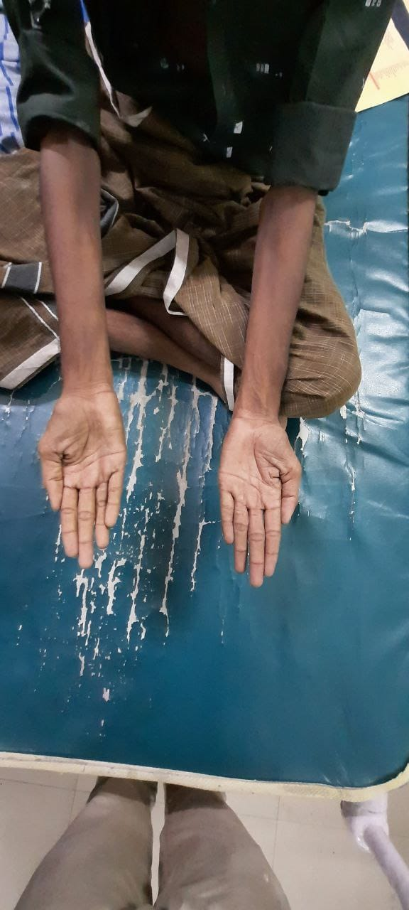
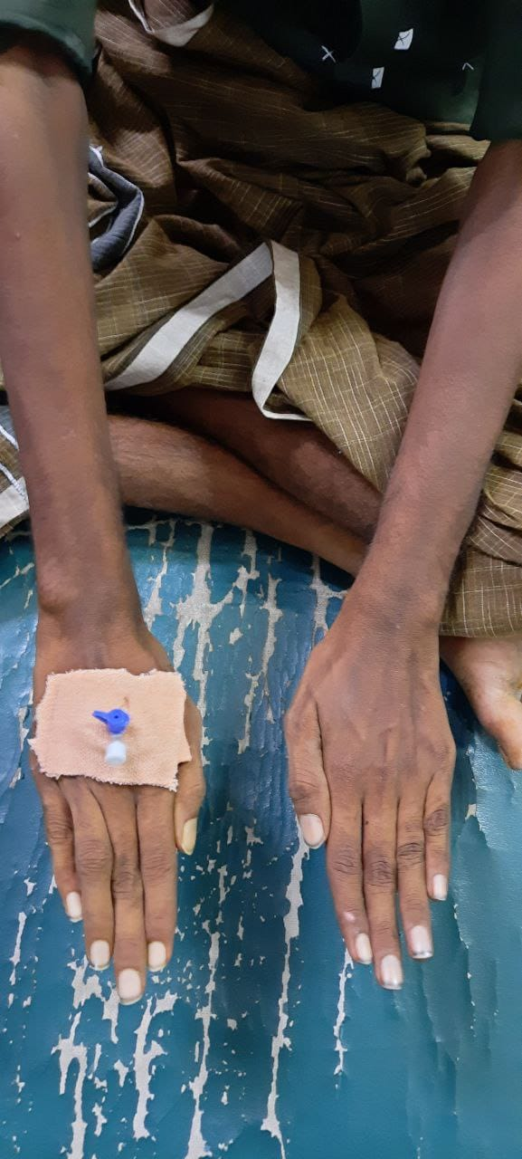
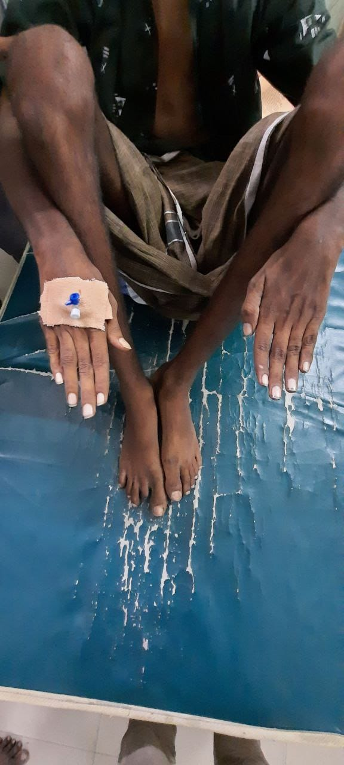
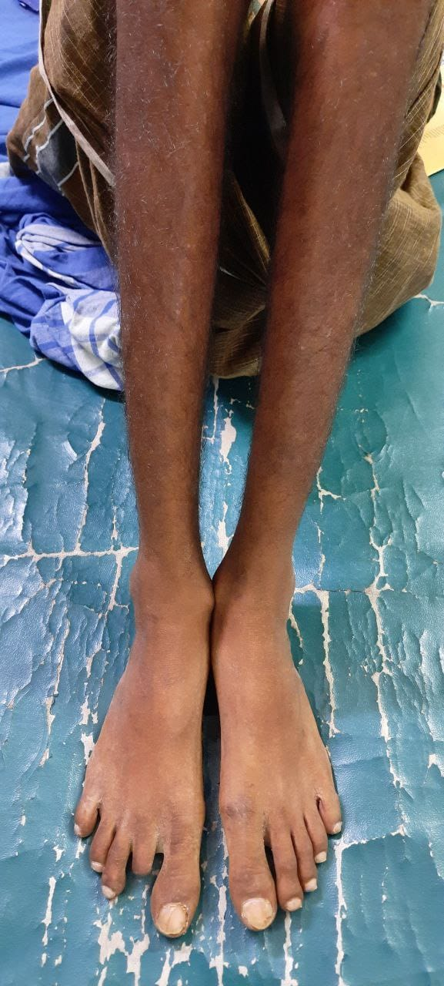

Slide 10
REFLEXES:
 | RIGHT | LEFT
BICEPS | BRISK | BRISK
TRICEPS | BRISK | BRISK
SUPINATOR | BRISK | BRISK
KNEE | EXAGGERATED | EXAGGERATED
ANKLE | ABSENT | ABSENT
PATELLAR CLONUS | (+) | (+)
ANKLE CLONUS | (-) | (-)
BILATERAL PLANTAR NO RESPONSE.

Slide 11
SENSORY SYSTEM EXAMINATION: NORMAL
BEEVOR SIGN:NEGATIVE
NO CEREBELLAR SIGNS
NO NECK STIFFNESS
SPINE AND CRANIUM NORMAL

Slide 12
INVESTIGATIONS:
HB:11.2 gm/dl
Tc:6200 cells/cu.mm
Pcv:37%
Platelet:3.75lakhs/cu.mm
RBC INDICES:
MCV:78 :MCH:23.5 :MCHC:30.1 RDW:68.3
PERIPHERAL SMEAR:Microcytic hypochromic anemia with anisopoikilocytosis.

Slide 13
Rbs:91 mg/dl
Urea:16 . Creatinine :0.8
Ecg: HR:75/min.sinus rhythm. T inversion in V2-V6 lead 1,2,avf
ECHO: Normal study.
Tsh:1.80(0.3-5.5)
HBSAG:negative. ANTI HCV: negative
Usg abdomen and pelvis: FATTY LIVER
VDRL:NON REACTIVE.

Slide 14
SERUM CHOLINESTERASE:1640U/L
REFERENCE(4900-11900)
CSF ANALYSIS:
CLEAR COLOURLESS
PROTEIN:40mg/dl
SUGAR:45mg/dl
Cells:5 cells/cu.mm
Globulin:Negative

Slide 15
Neurophysician opinion:
IMPRESSION: SPASTIC PARAPLEGIA PROBABLY HYPOXIC ETIOLOGY.
SUGGESTION:
MRI C SPINE WITH WHOLE SPINE AND BRAIN
SCREENING.
PHYSIOTHERAPY

Slide 16
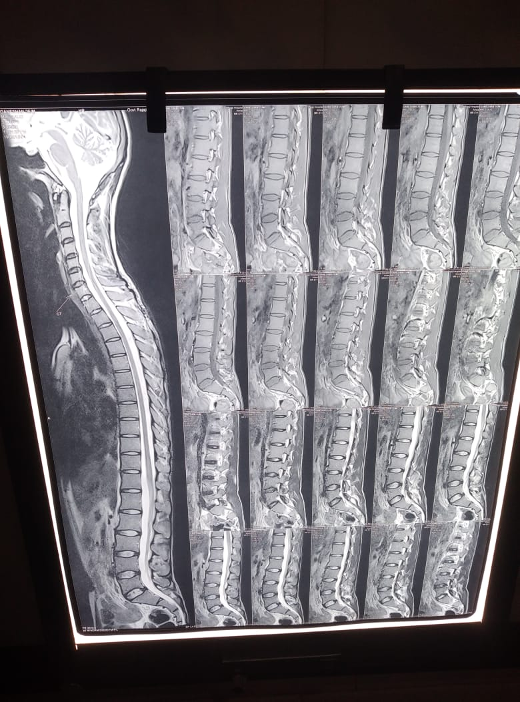
MRI LS SPINE WITH WHOLE SPINE AND BRAIN SCREENING:

Slide 17
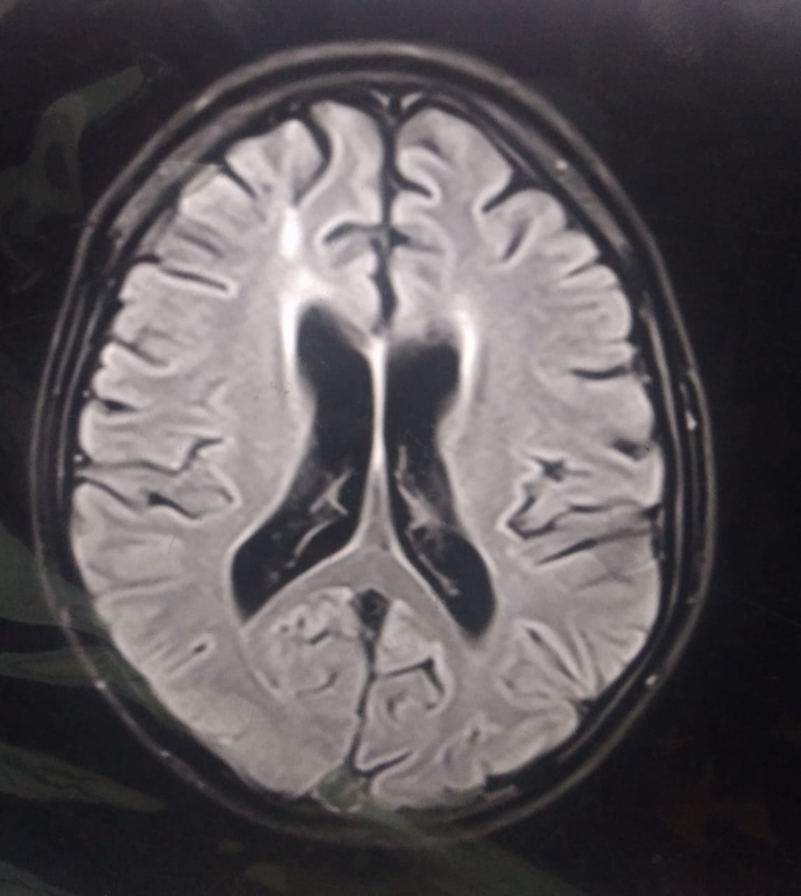
TOXIC DEMYELINATION NOTED IN LOWER THORACIC SEGMENTS. MRI BRAIN SHOWS PERIVENTRICULAR HYPERINTENSITY PROBABLY TOXIC DEMYELINATION.

Slide 18
FINAL DIAGNOSIS:
A CASE OF ACUTE SPASTIC PARAPARESIS DUE TO DELAYED OPC TOXICITY.

Slide 19
AIM OF THE PRESENTATION:
TO EMPHASIZE LATE NEUROLOGICAL MANIFESTATION OF OPC POISONING
ENHANCED NEUROTOXICITY OF OPC AND PYRETHROID COMBINATION

Slide 20
THANK YOU

